Slide 1
Trip Advisor Dashboard created by ANIMESH KUMAR
File created on: 08-04-2023 00:47:57

Slide 2
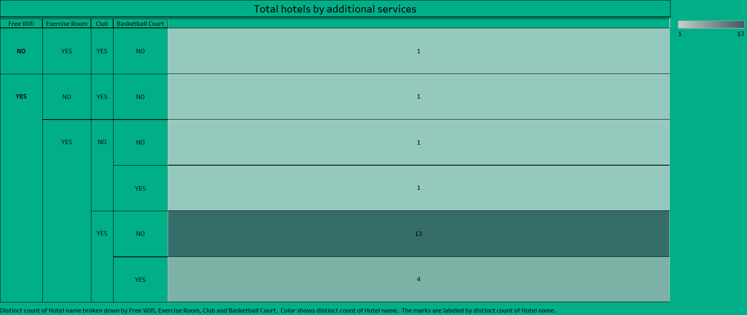

Slide 3
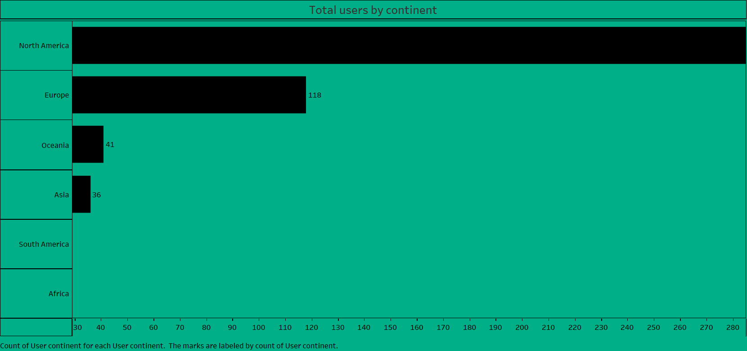

Slide 4
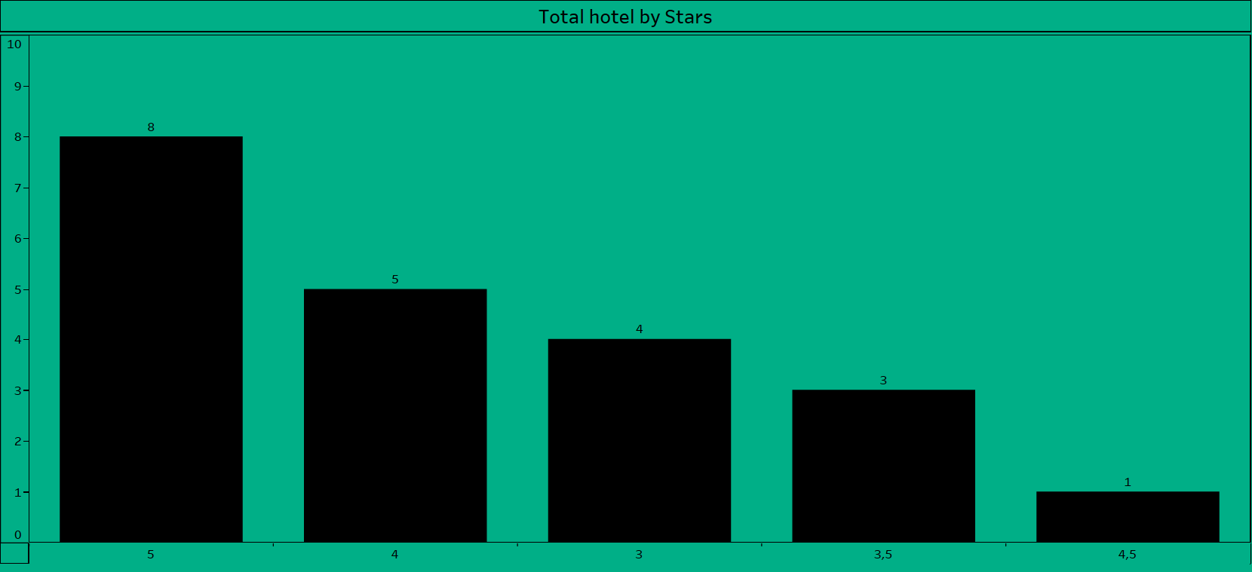

Slide 5
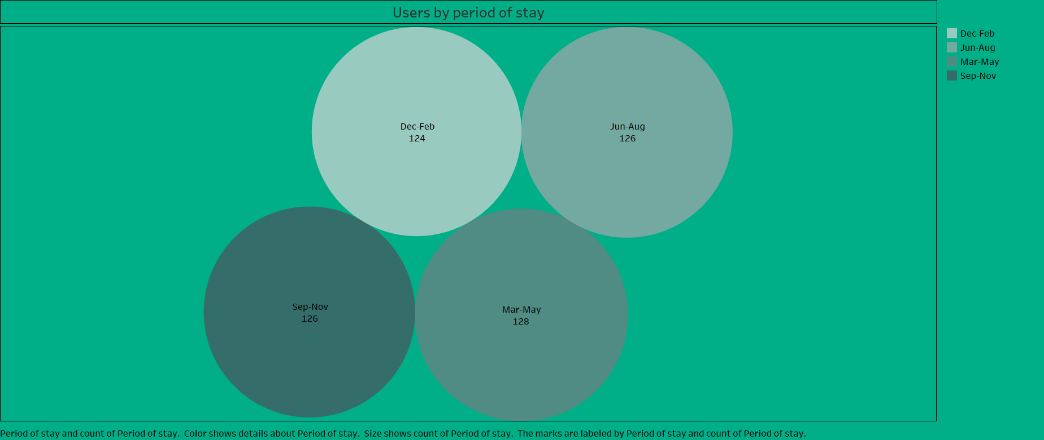

Slide 6
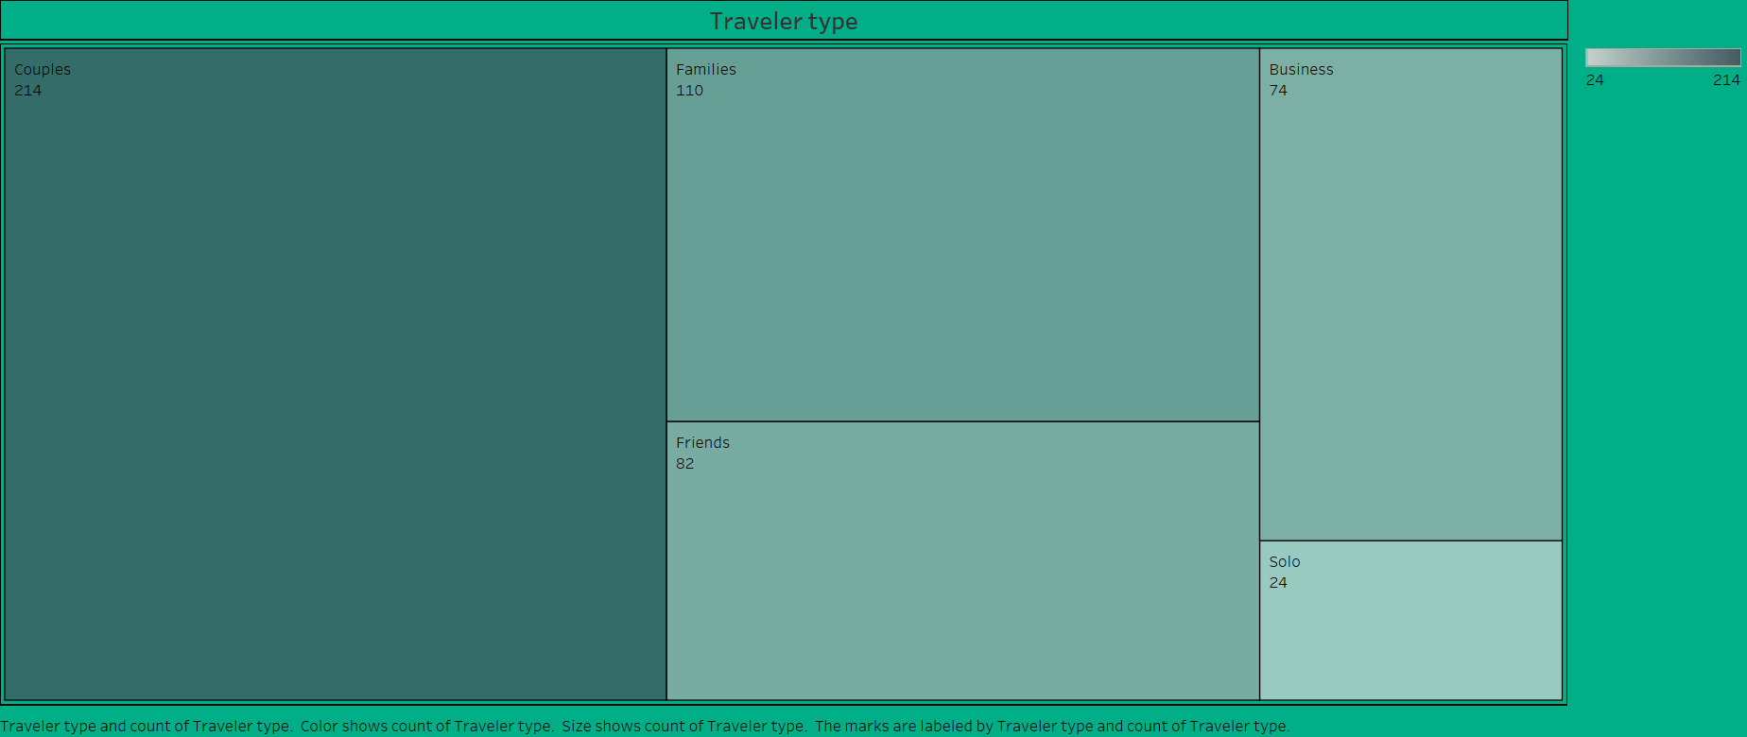

Slide 7
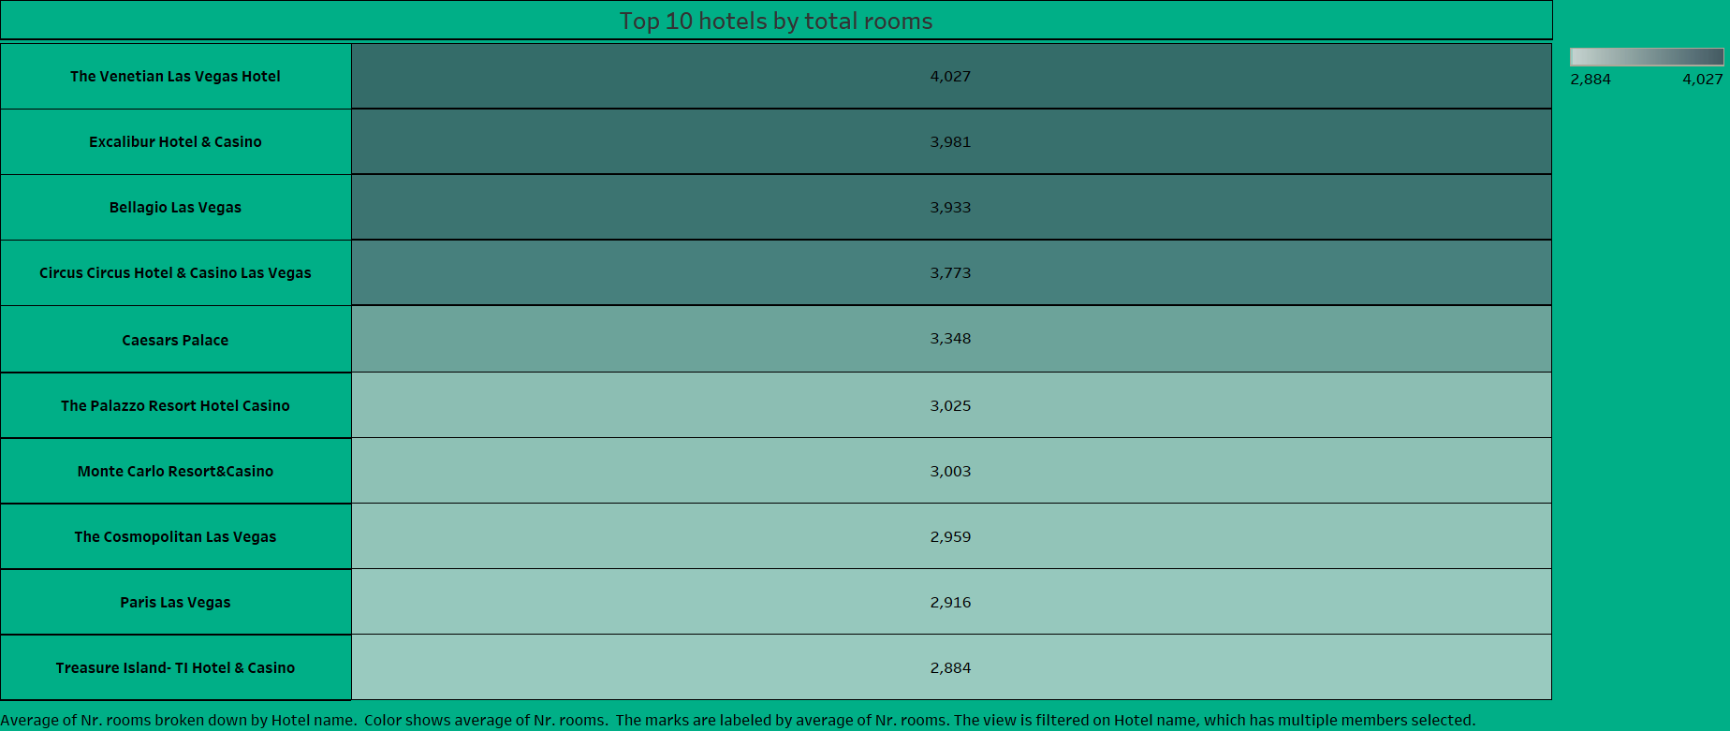

Slide 8
